Slide 1
An Intelligent Financial Advisor
Student Name: CHEN Ziyang
Student ID No. 21095751D
Programme-Stream Code: 62435-FFT
Supervisor: Dr. LEONG Hong Va
Co-Examiner: Dr. XIA Xianjin
Working with LEE, Ka Chun Caius, 20069386D

Slide 2
Table of contents
Introduction & Problem Statement
Objectives and Outcome
Project Methodology
Design and Development
Implementation
Result analysis and Reflection
Demonstration
Conclusion
Reference

Slide 3

1. Introduction & Problem Statement
Introduction
Aging Society Challenges
Traditional Financial Planners: High fees and low efficiency
FinTech & AI quickly development
Greater efficiency and lower fees intelligent services are needed
Problem Statement
Difficulty to predict future Scenario and ensure asset value preservation
Lack of risk assessment tools to personalize user assets
Lack of affordable professional financial planning services.
Figure 1. AI Financial Advisor [1]
Notes:
An aging society is making it increasingly importance of growing wealth to match inflation and prepare for retirement.

Slide 4
2. Objectives and Outcome
Portfolio Allocation Based on User Risk Tolerance
Predict risk tolerance and Generate user portrait based on user info.
Allocate assets based on user risk tolerance and mean-variance optimization.
Help user min risk while max potential growth, make wise financial decisions.
Portfolio Historical Performance
Multi-portfolio backtesting with different asset allocations.
Assess portfolios performance with metrics (final balance, CAGR, max drawdown, and Sharpe ratio) over past periods, including withdrawals and rebalancing.
Help users to evaluate the past risk and return of the portfolios.
Simulator Tool
Simulate future financial scenarios using three types of models. (Historical, Statistical, Parametric simulation)
Test portfolios under optimistic, pessimistic, or baseline conditions.
Help users prepare for potential future economic outcomes.
Notes:
Our goal is to create an Intelligent Financial Advisor System.
First, the system can predict risk tolerance and allocate assets based on user risk tolerance.

Slide 5
3. Project Methodology

Slide 6
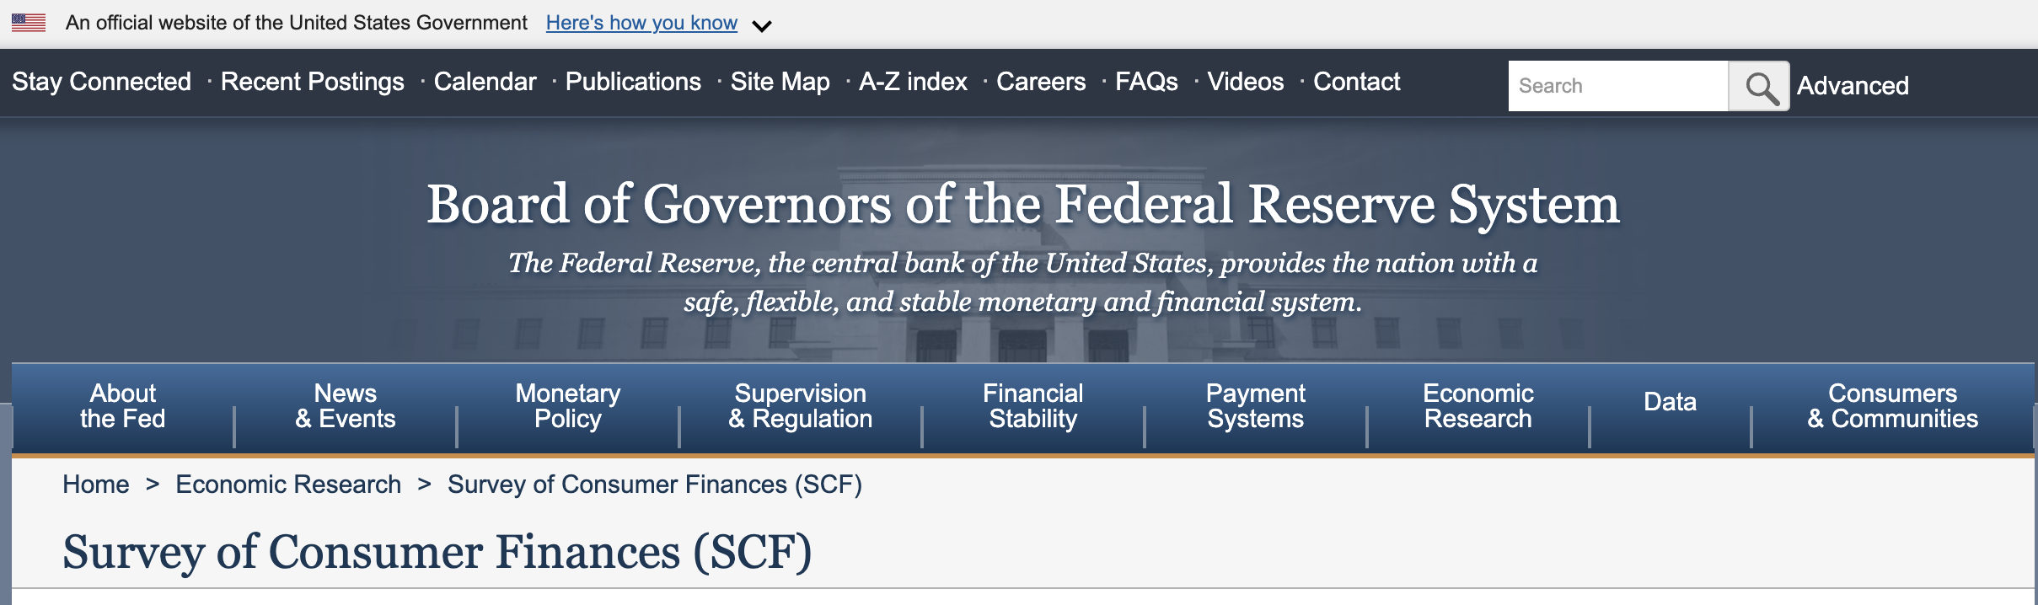
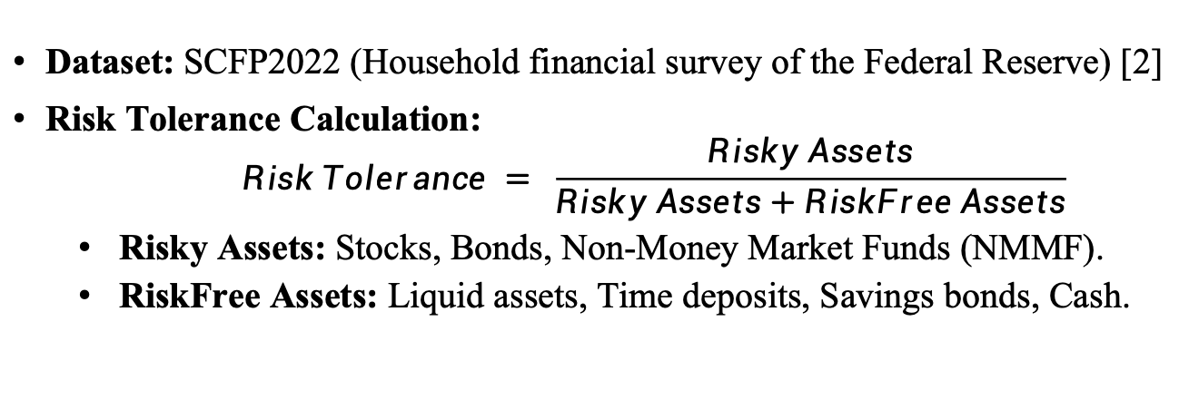
Project Methodology (Risk Tolerance Calculation)
Figure 3. SCFP2022 (Household financial survey of the Federal Reserve) [2]
Dataset: SCFP2022 (Household financial survey of the Federal Reserve) [2]
Risk Tolerance Calculation:
$$Risk Tolerance = \frac{Risky Assets}{Risky Assets+RiskFree Assets}$$
Risky Assets: Stocks, Bonds, Non-Money Market Funds (NMMF).
RiskFree Assets: Liquid assets, Time deposits, Savings bonds, Cash.
Notes:
We use the SCFP2022 dataset to assess users' financial status and risk tolerance. The key here is predicting the 'Risk Tolerance', which is calculated by comparing the ratio of risky assets to total assets.

Slide 7
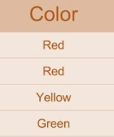
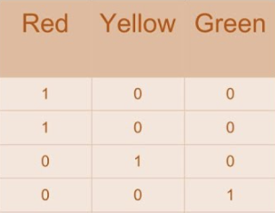
Project Methodology (Data Processing & Feature Engineering)
Handling Missing Values
One-Hot Encoding: Convert categorical variables into separate binary features.
Categorical variables: Education level, marital status, occupation.
Feature Selection:
Key Features: Age, Income, Education, Occupation, Marital Status.
Method: Use ML model for initial feature selection.
Domain Knowledge: Combined with financial expertise to refine feature choices.
Figure 4. One-Hot Encoding Example [3]

Slide 8
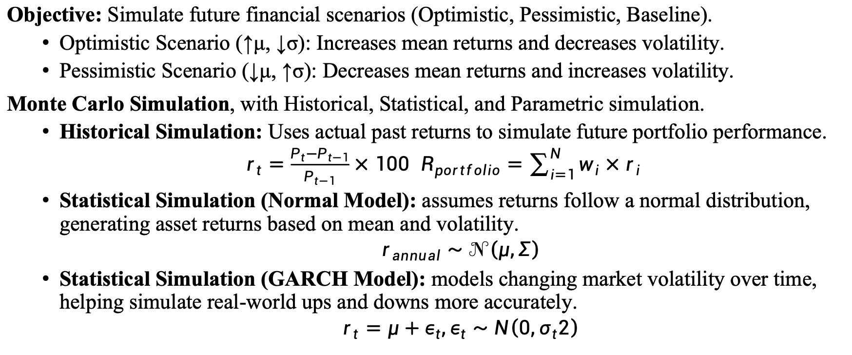
Project Methodology (Portfolio Simulation)
Objective: Simulate future financial scenarios (Optimistic, Pessimistic, Baseline).
Optimistic Scenario (↑μ, ↓σ): Increases mean returns and decreases volatility.
Pessimistic Scenario (↓μ, ↑σ): Decreases mean returns and increases volatility.
Monte Carlo Simulation, with Historical, Statistical, and Parametric simulation.
Historical Simulation: Uses actual past returns to simulate future portfolio performance.
$r_{t}=\frac{P_{t}−P_{t−1}}{P_{t−1}}×100$ $R_{portfolio}=\sum_{i=1}^{N}{w_{i}×r_{i}}$
Statistical Simulation (Normal Model): assumes returns follow a normal distribution, generating asset returns based on mean and volatility.
$$r_{annual​}∼𝒩\left(μ,Σ\right)$$
Statistical Simulation (GARCH Model): models changing market volatility over time, helping simulate real-world ups and downs more accurately.
$$r_{t}​=μ+ε_{t}​,ε_{t}​∼N\left(0,σ_{t}2​\right)$$
Notes:
We consider three scenarios in future simulations. In the Optimistic scenario, we increase mean returns and decrease volatility, while in the Pessimistic scenario, we reduce returns and increase volatility.

Slide 9
Project Methodology (Portfolio Simulation)
The Parameterized Simulation: Defines parameters for return distribution (adjusts mean 𝜇 and volatility 𝜎) to simulate returns based on Lognormal distribution.
Annualized Mean (𝜇): A higher mean results in greater expected returns.
Adjusting 𝜇 shifts the central value of asset returns.
Increasing 𝜇 increases expected returns
Annualized Volatility (𝜎): A higher volatility increases risk and return fluctuation.
Adjusting 𝜎 alters the dispersion of returns, affecting risk.
increasing 𝜎 introduces more risk.
Covariance & Correlation : Affects portfolio risk by describing how assets move together.
High correlation leads to concentrated risk.
Notes:
The Parameterized Simulation adjusts parameters like mean 𝜇 and volatility 𝜎, allowing us to simulate asset returns based on lognormal distribution.
Increasing 𝜇 increases expected returns, while increasing 𝜎 introduces more risk.

Slide 10
4. Design & Development

Slide 11
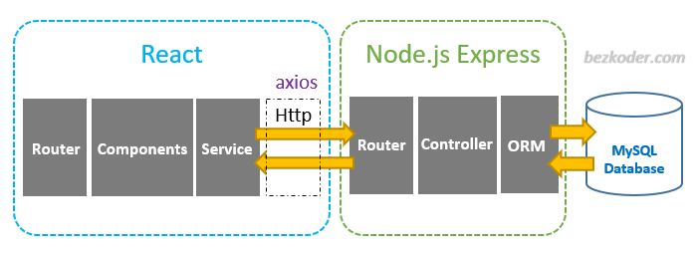
Design & Development
The system adopts a front-end and back-end separation architecture.
Server: Node.js + Express + Flask
Database: Amazon Web Services RDS for MySQL (stores user data)
Front-end: React framework + UI (Ant)
Local csv files: store market data (daily update using Kaggle dataset) [4].
Figure 5. React + Node.js + Express + Amazon Web Services RDS Overview [5]

Slide 12
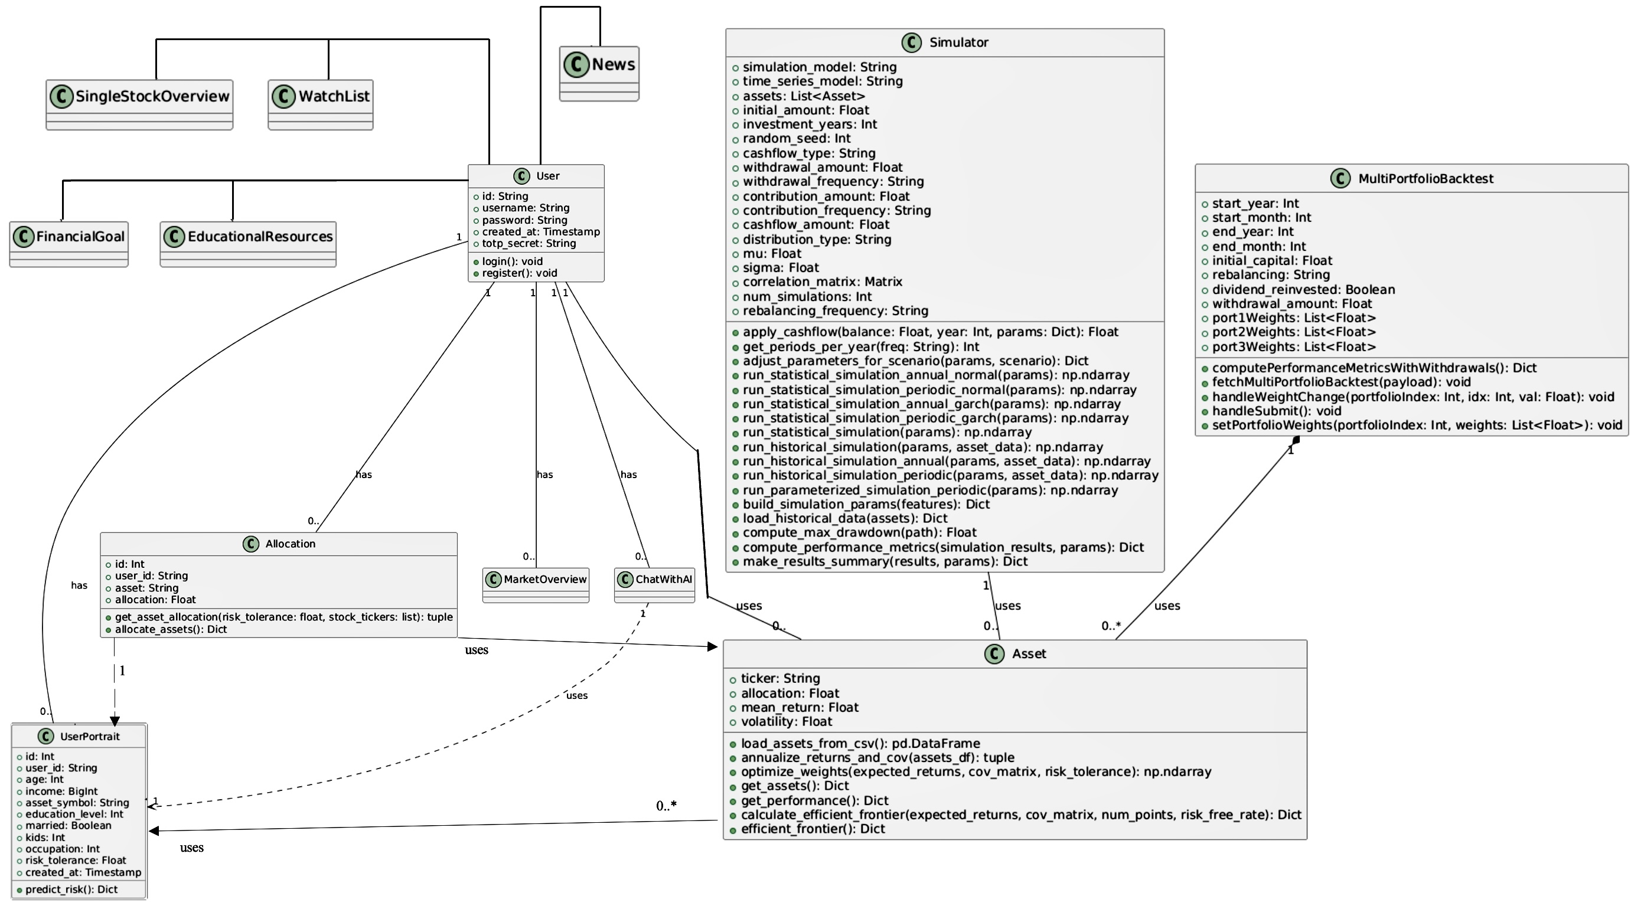
Design and Development - Components
Group project with my teammate LEE, Ka Chun Caius (20069386D). My personal contribution is detailed with attributes and methods. There are three main components in my contribution:
User Portrait
Multi-Portfolio Back test
Simulator
UserPortfolio one-to-many (1:0..*) relationship with Allocation.
MultiPortfolioBacktest has zero-to-many (0..*) relationship with Asset.
Simulator has a one-to-many (1:0..*) relationship with Asset.
Figure 6. Class Diagram of the System Architecture

Slide 13
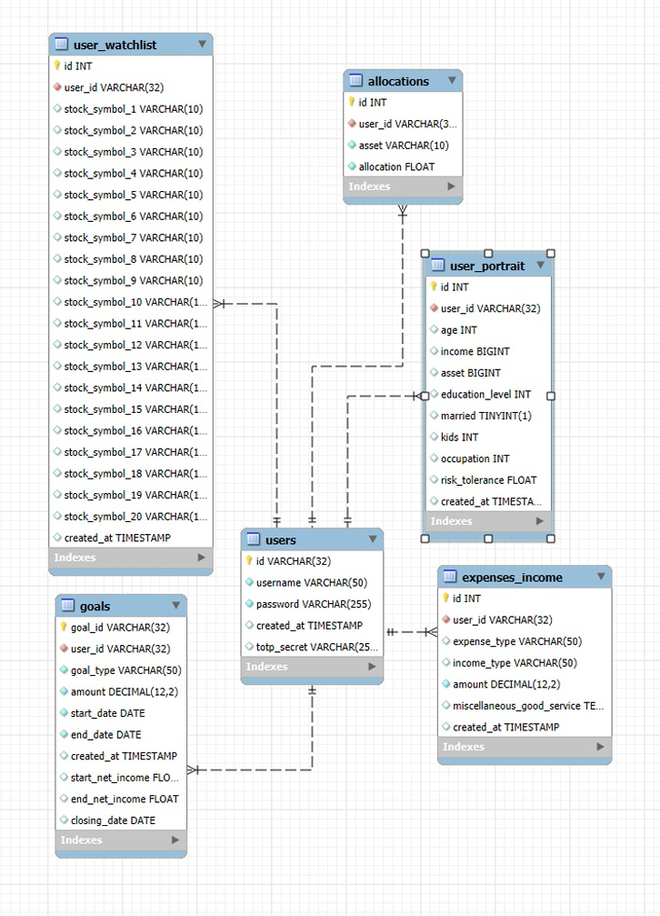
Design and Development - Database Design and Normalization
Goal: Store and manage user data (personal information, investment portfolios, financial goals, consumption records, etc.)
Relational database: MySQL
Cloud service platform: Amazon RDS for MySQL
Normalized design: Follows the 1NF (atomic), 2NF (no partial dependencies) and 3NF (no transitive dependencies)
user_portrait table: records user’s basic information and risk tolerance (generated by ML model);
allocations table: records user's asset allocation;
All tables are connected to the users table via the foreign key user_id.
Figure 7. ER Diagram of the database

Slide 14
5. Implementation

Slide 15
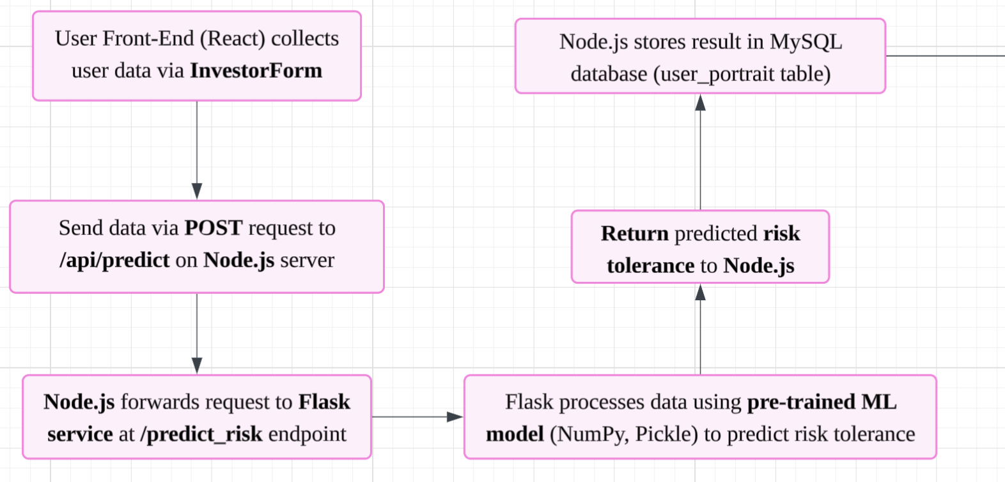
5.1 User Portrait Module – Implementation
Save, update and manage the user's basic information. Machine Learning model predicts risk tolerance. Allocate personalized investment portfolio.
Backend (Flask + Node.js)
/predict_risk
/allocate
/get_performance
/efficient_frontier
Database (MySQL on AWS RDS)
user_portrait, allocations
Frontend (React + Recharts):
InvestorForm Collects input for prediction.
AllocationChart, PerformanceChart, EfficientFrontierChart: Visualize AI-generated allocation and return.
Figure 8. User Risk Tolerance Prediction Workflow
Notes:
First, the user enters their personal data through the InvestorForm on the front-end.
Once submitted, this data is sent to the backend via a POST request.
The backend then processes this data.
Node.js forwards the request to the Flask service, which uses a pre-trained machine learning model to predict the user's risk tolerance based on the provided information. The result is returned to Node.js and saved in the database for future use.

Slide 16
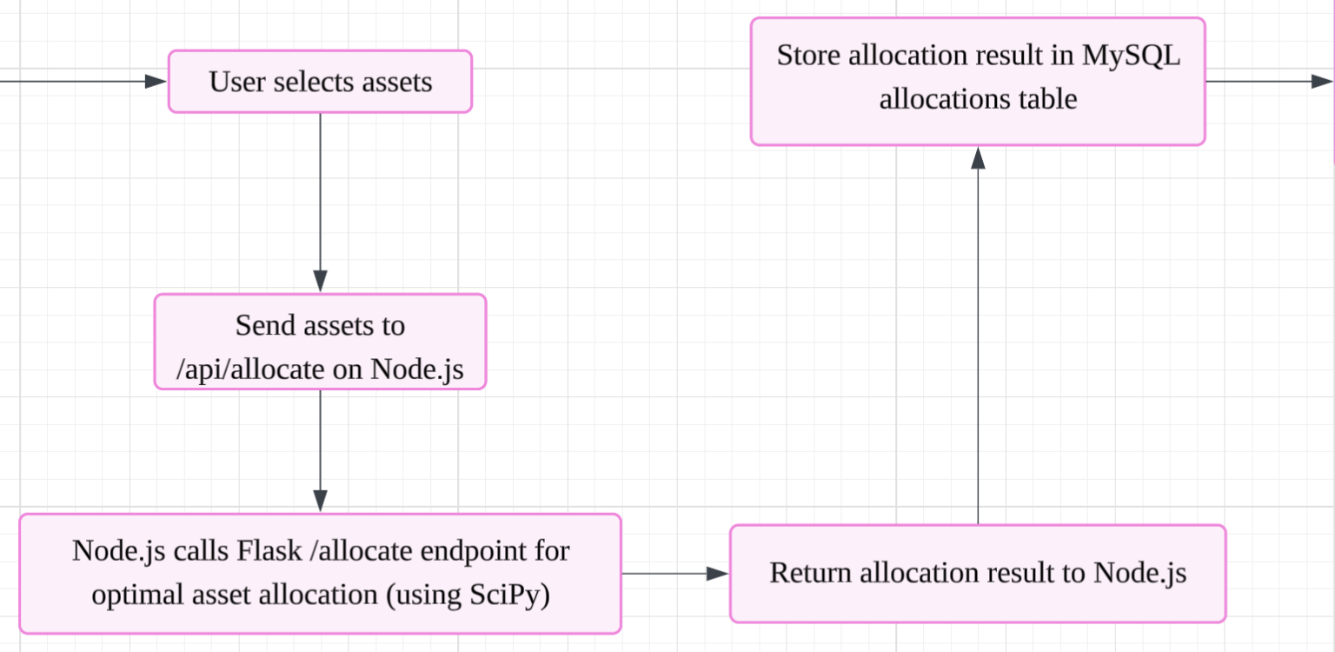
5.1 User Portrait Module – Implementation
Save, update and manage the user's basic information. Machine Learning model predicts risk tolerance. Allocate personalized investment portfolio.
Backend (Flask + Node.js)
/predict_risk
/allocate
/get_performance
/efficient_frontier
Database (MySQL on AWS RDS)
user_portrait, allocations
Frontend (React + Recharts):
InvestorForm Collects input for prediction.
AllocationChart, PerformanceChart, EfficientFrontierChart: Visualize AI-generated allocation and return.
Figure 9. Asset Allocation Process Flow
Notes:
Next, the system calculates the optimal asset allocation.
The user selects the assets they are interested in, and the backend calculates the best allocation based on their risk tolerance.
This process uses historical stock data and optimization algorithms to generate the most efficient portfolio.

Slide 17
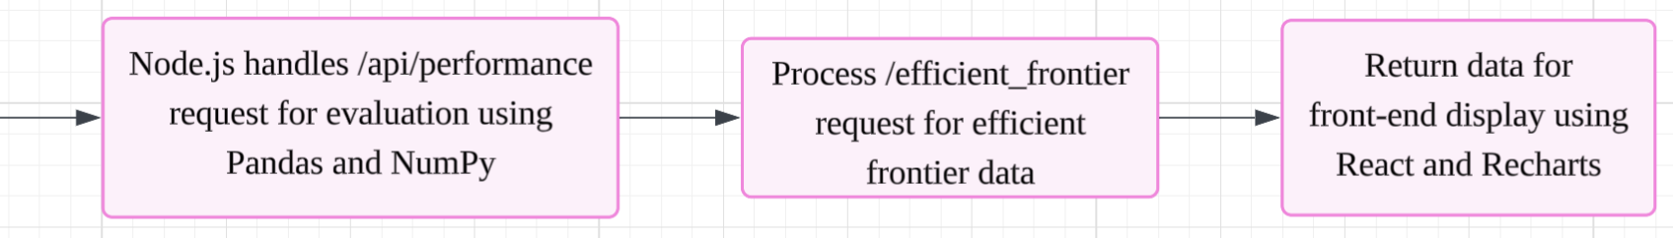
5.1 User Portrait Module – Implementation
Save, update and manage the user's basic information. Machine Learning model predicts risk tolerance. Allocate personalized investment portfolio.
Backend (Flask + Node.js)
/predict_risk
/allocate
/get_performance
/efficient_frontier
Database (MySQL on AWS RDS)
user_portrait, allocations
Frontend (React + Recharts):
InvestorForm Collects input for prediction.
AllocationChart, PerformanceChart, EfficientFrontierChart: Visualize AI-generated allocation and return.
Figure 10. Performance Evaluation and Efficient Frontier Calculation Process
Notes:
Finally, the system evaluates the portfolio's performance and computes the efficient frontier.
All of this data is returned to the front-end and displayed to the user

Slide 18
5.2 Risk Tolerance predicting Implementation
Data Preprocessing: Remove rows with missing values (NaN), infinity (inf), and negative infinity (-inf).
One-Hot Encoding: Categorical variables (e.g., Education Level, Marital Status) were transformed into binary features. Avoids introducing bias that could arise from treating categories as ordinal.
Feature Selection: Used RandomForest to assess feature importance. Combined with domain knowledge and project requirement to select features like age, education level, income.
Model Training: Tested multiple models. ExtraTreesRegressor perform the best, and tuned ExtraTreesRegressor with RandomizedSearchCV for optimal performance.
Risk Tolerance Prediction: User submits financial data through the front-end. Back-end processes the data using the trained model and outputs a risk tolerance value (1 to 5).

Slide 19
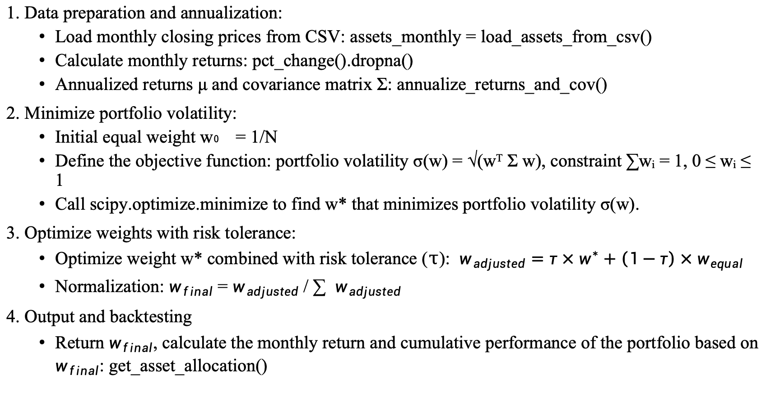
5.3 Dynamic Asset Allocation Implementation
1. Data preparation and annualization:
Load monthly closing prices from CSV: assets_monthly = load_assets_from_csv()
Calculate monthly returns: pct_change().dropna()
Annualized returns μ and covariance matrix Σ: annualize_returns_and_cov()
2. Minimize portfolio volatility:
Initial equal weight w₀ = 1/N
Define the objective function: portfolio volatility σ(w) = √(wᵀ Σ w), constraint ∑wᵢ = 1, 0 ≤ wᵢ ≤ 1
Call scipy.optimize.minimize to find w* that minimizes portfolio volatility σ(w).
3. Optimize weights with risk tolerance:
Optimize weight w* combined with risk tolerance ($τ$): $w_{adjusted}=τ×w^{∗}+\left(1−τ\right)×w_{equal}$
Normalization: $w_{final}$ = $w_{adjusted}$ / ∑ $w_{adjusted}$
4. Output and backtesting
Return $w_{final}$, calculate the monthly return and cumulative performance of the portfolio based on $w_{final}$: get_asset_allocation()

Slide 20
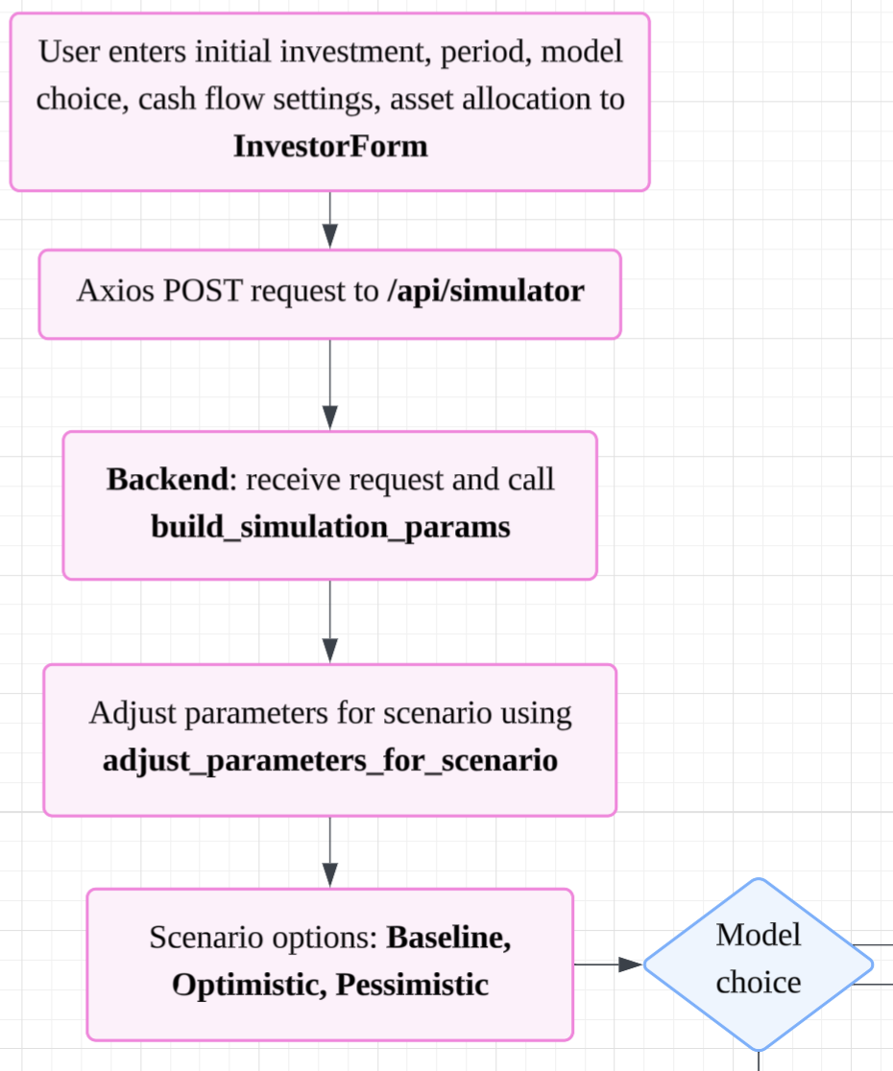
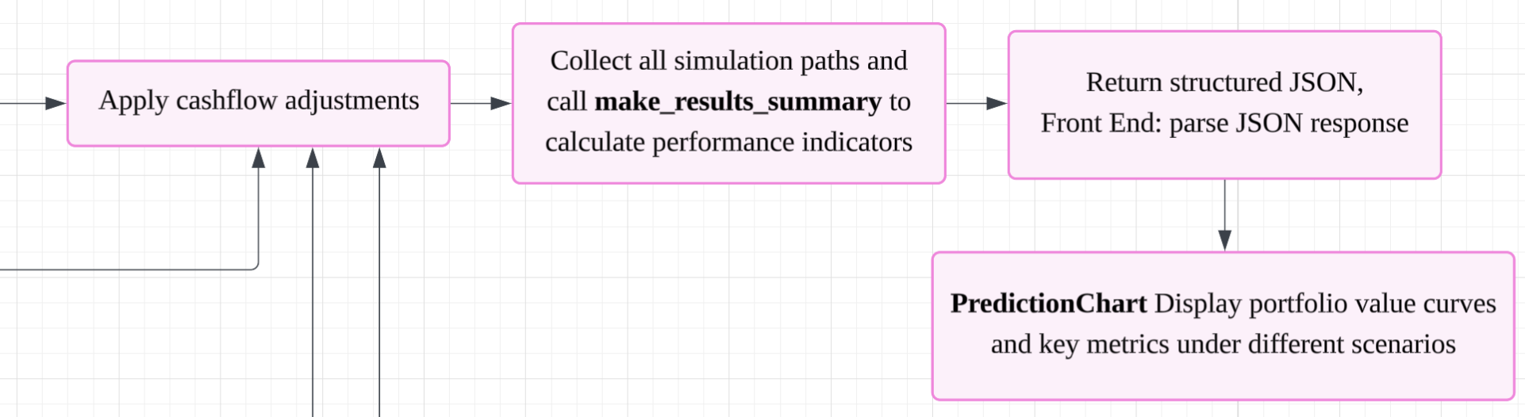
5.4 Simulation Module - Implementation
Purpose: simulate portfolio performance under different market scenarios (Optimistic, Pessimistic, Baseline).
Built‑in scenario adjustment & cash‑flow functions.
Three Monte Carlo simulation: historical, statistical, parametric.
Backend (Flask):
/api/simulator accepts JSON, builds params via build_simulation_params()
Calls adjust, then selected run function, collects results via make_results_summary()
Returns structured JSON per scenario
Frontend (React):
InvestorForm gathers inputs, validates weights = 100%
Axios POST to /api/simulator with JWT
Displays PredictionChart & metrics table under tabs
Figure 11. Simulation Module Flowchart
Notes:
The users fill in their investment details and model choice,
Send POST request to simulator route,
the Flask receive the JSON data and build the parameters for each scenario,
runs the chosen Monte Carlo simulation,
Finally, returns a JSON to the React and display data.

Slide 21
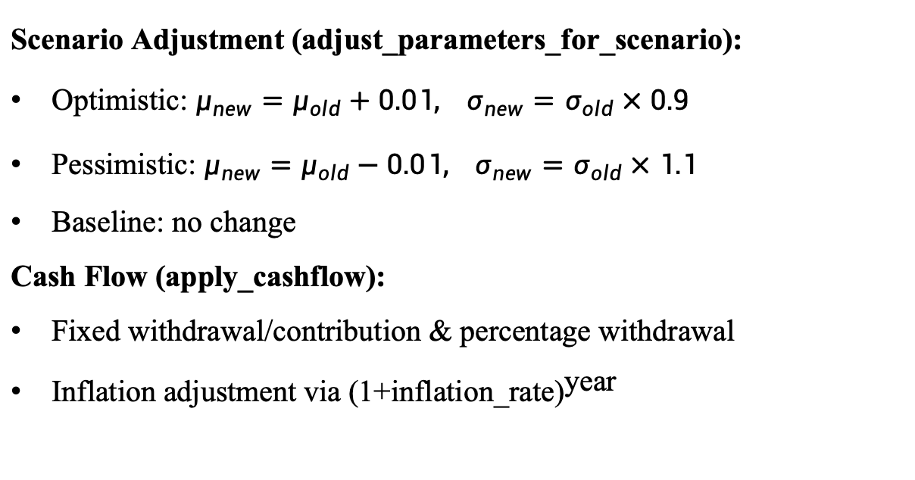
5.4 Simulation Module - Implementation
Scenario Adjustment (adjust_parameters_for_scenario):
Optimistic: $μ_{new}=μ_{old}+0.01, σ_{new}=σ_{old}×0.9$
Pessimistic: $μ_{new}=μ_{old}−0.01, σ_{new}=σ_{old}×1.1$
Baseline: no change
Cash Flow (apply_cashflow):
Fixed withdrawal/contribution & percentage withdrawal
Inflation adjustment via ${\text{(}\text{1}\text{+}\text{inflation}\text{_}\text{rate}\text{)}}^{\text{year}}$
Figure 11. Simulation Module Flowchart
Notes:
we also offer function to adjust our inputs for each scenario
And in cash‑flow function: it handles withdrawals or contributions
and even adjusts for inflation each year.

Slide 22
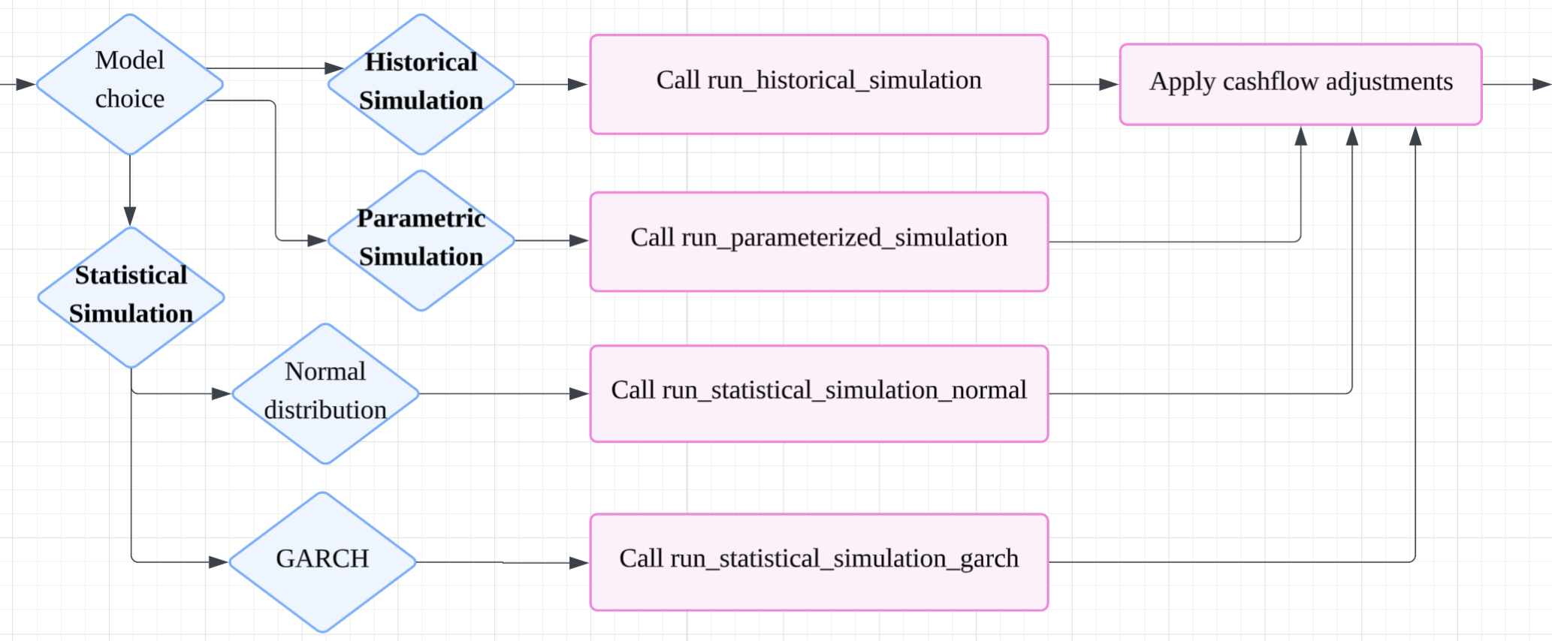
5.4 Simulation Module (Historical) - Implementation
Repeatedly sample past monthly returns (eg. randomly extracts 12 returns), compound them into annual portfolio returns based on asset weights
Calls apply_cashflow to update the account balance.
Iterate across years and Monte Carlo paths to build a full distribution of potential portfolio values.
The main functions: run_historical_simulation_annual.
Figure 12. Simulation Module Flowchart (model part)
Notes:
In the historical simulation, we repeatedly sample past monthly returns, compound them into annual portfolio returns based on asset weights
Apply cash-flow adjustments
and iterate across years and Monte Carlo paths to build a full distribution of potential portfolio values.

Slide 23
5.4 Simulation Module (Statistical) - Implementation
The normal model assumes the asset return rate follows a normal distribution with a fixed mean and fixed volatility.
The GARCH model treats "volatility" as a variable that changes over time. Continuously update the current conditional variance based on the historical forecast errors (residuals) and past volatility levels.
Related functions: run_statistical_simulation_normal, run_statistical_simulation_garch
Figure 12. Simulation Module Flowchart (model part)

Slide 24
5.4 Simulation Module (Parametric) - Implementation
Does not rely on any historical data.
Directly samples according to the Lognormal distribution based on the μ and σ input by the user
Calls apply_cashflow to complete the cash flow processing.
The main functions: run_parameterized_simulation
Figure 12. Simulation Module Flowchart (model part)

Slide 25
6. Result analysis and Reflection

Slide 26
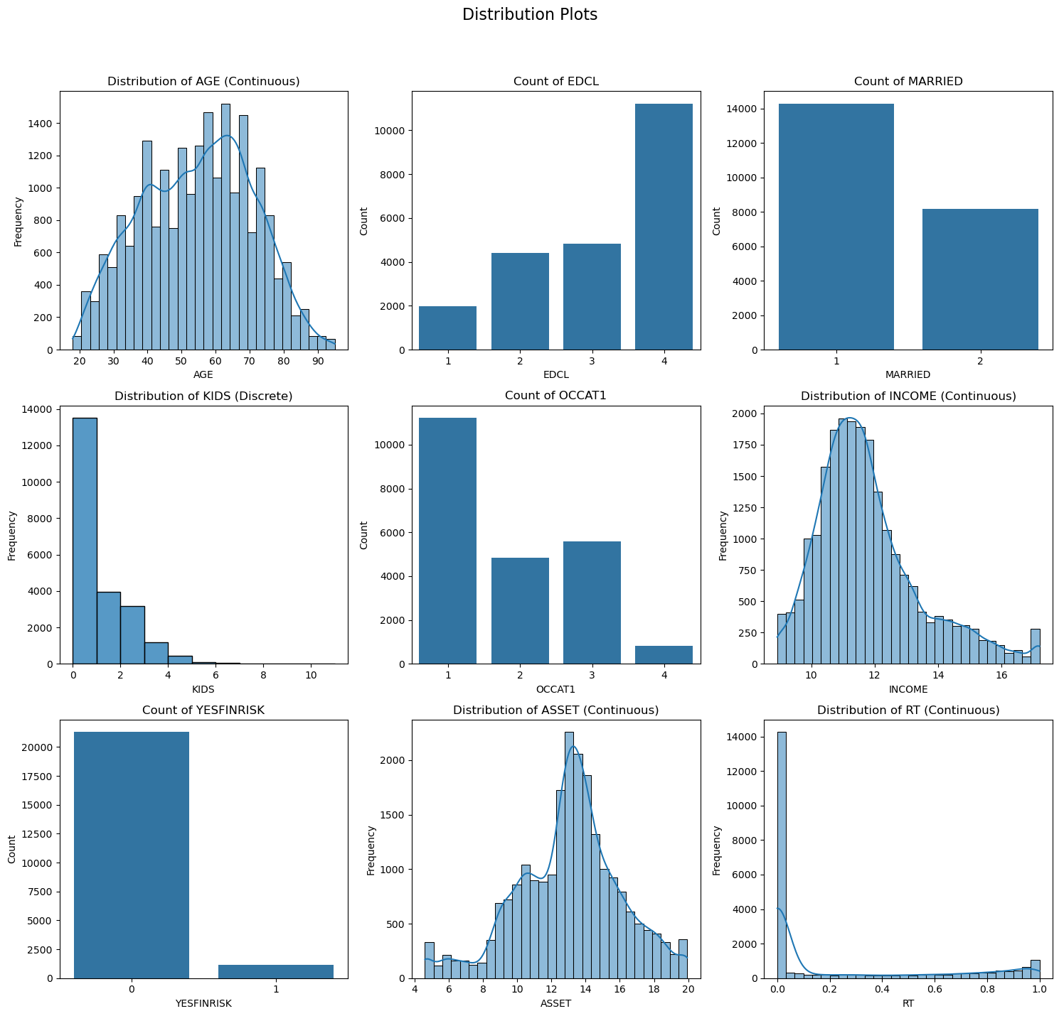
6.1 Dataset
Dataset: SCFP2022
Published by the Federal Reserve Board (FRB) of the US [2].
Category: EDCL, MARRIED, OCCAT1, YESFINRISK
Discrete numeric: KIDS
Continuous numeric: AGE, INCOME, ASSET, RT
Figure 13. Feature Distribution

Slide 27
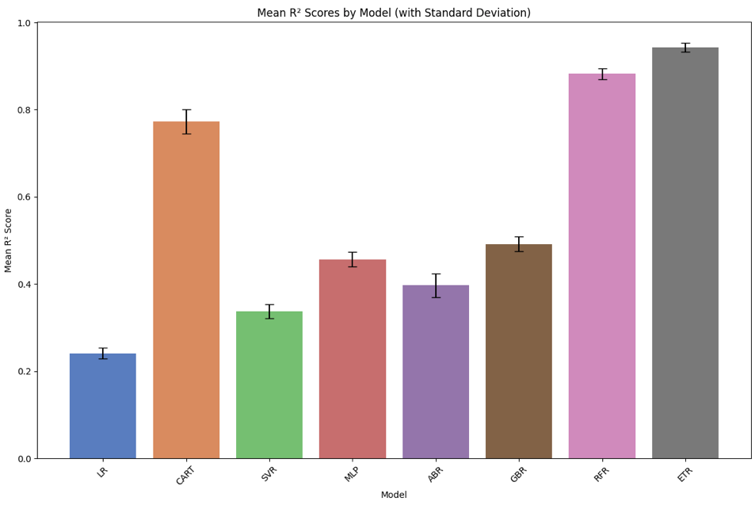
6.2 Model Training
10-fold cross-validation
R² as the performance score
Model: LR, decision trees, SVR, MLP, RandomForest Regressor, ExtraTreesRegressor
GridSearchCV to tuned hyperparameters
ExtraTreesRegressor performs the best!
Figure 14. Overall Model Performance

Slide 28
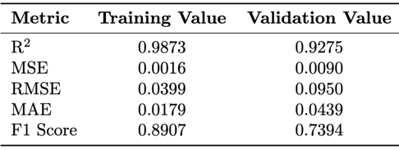
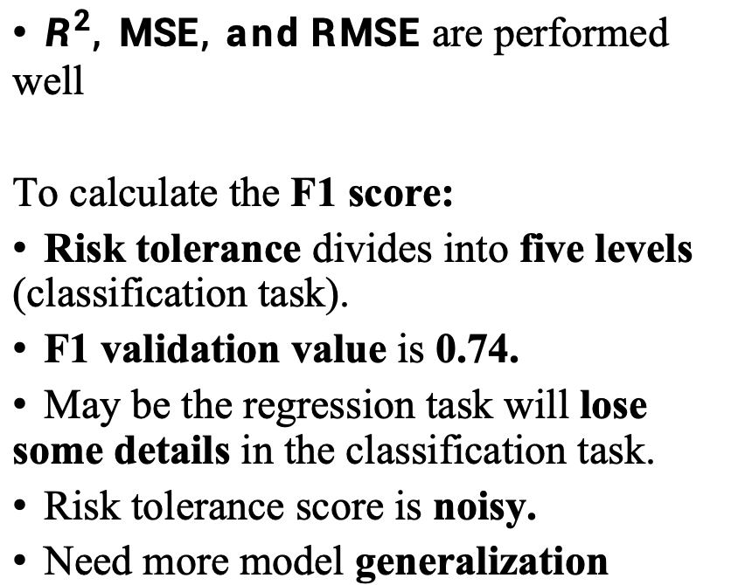
6.3 ExtraTreesRegressor Model evaluation results
$R^{2}, MSE, and RMSE$ are performed well
To calculate the F1 score:
Risk tolerance divides into five levels (classification task).
F1 validation value is 0.74.
May be the regression task will lose some details in the classification task.
Risk tolerance score is noisy.
Need more model generalization
Table 1. ExtraTreesRegressor model evaluation results

Slide 29
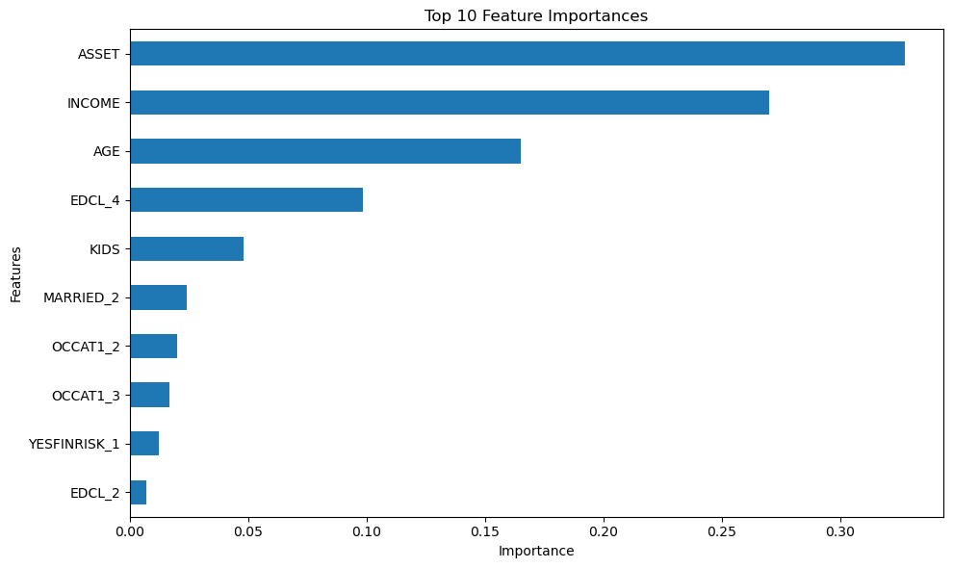
6.4 the Reflection of Feature Importance
Most important features: ASSET, INCOME
Financial resources is the core role of the wealth safety net.
EDCL_4 vs EDCL_2: Education NOT ONLY improves knowledge, BUT ALSO affects decision-making by improving economic status and cognitive ability
High education (EDCL_4): Master more information and resources → Stronger risk management ability
Low education (EDCL_2): Face uncertainty and pressure → Limited risk tolerance
Figure 15. Feature Importance

Slide 30
7. Demonstration

Slide 31
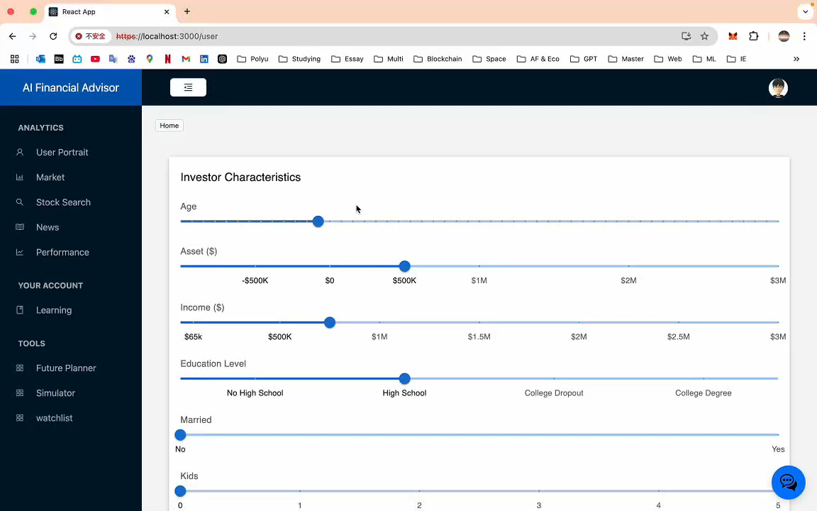

Slide 32
8. Conclusion
Successfully built risk preference prediction model
ASSET and INCOME are key factors in risk tolerance
Achieved Dynamic asset allocation
Simulation tool supports multi-scenario testing
Inspiration: Increasing asset and education support for low-income and low-education groups. This system can be used as an inclusive financial tool to help users make smarter financial decisions
Future work: Optimize model generalization, expand data sources

Slide 33
9. Reference
B. Vereckey, “Can generative AI provide trusted financial advice?,” MIT Sloan. [Online]. Available: https://mitsloan.mit.edu/ideas-made-to-matter/can-generative-ai-provide-trusted-financial-advice
Survey of Consumer Finances (SCF), “Changes in U.S. family finances from 2019 to 2022: Evidence from the survey of consumer finances,” Federal Reserve Bulletin, Oct. 2023. doi:10.17016/8799
DigitalSreeni, “137 - What is one hot encoding in machine learning?,” YouTube, [Online]. Available: https://www.youtube.com/watch?v=i2JSH5tn2qc.
Yash, “S&P500 Daily Update dataset,” Kaggle. [Online]. Available: https://www.kaggle.com/datasets/yash16jr/s-and-p500-daily-update-dataset.
Bezkoder, “React + node.js + express + mysql example: Build a crud app,” BezKoder. [Online]. Available: https://www.bezkoder.com/react-node-express-mysql/.

